Slide 1
Machine Learning Algorithm in Loan Repayment
Presenter: Weixi Liu, Yixuan Jiao
Xie Tian, Fengrui Zhang
12/13/2018

Slide 2
What is LendingClub?
LendingClub is a US peer-to-peer lending company, which operates an online lending platform. In Exchange for returns, investors purchase notes backed by payments made on loans.
Our target is to investigate company money lending decision according to the features of each client.

Slide 3
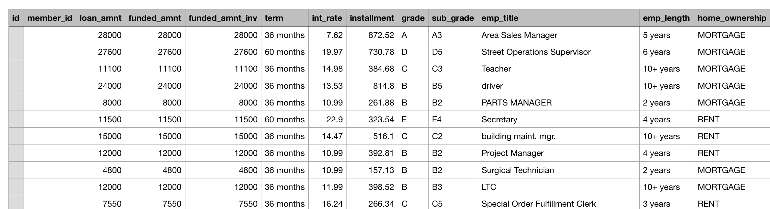
What is our Dataset?
Column: Include 136 client feathers
Row: Over 1.5 million lending records last 10 years
Label: Payment status, “Good” or “bad”

Slide 4
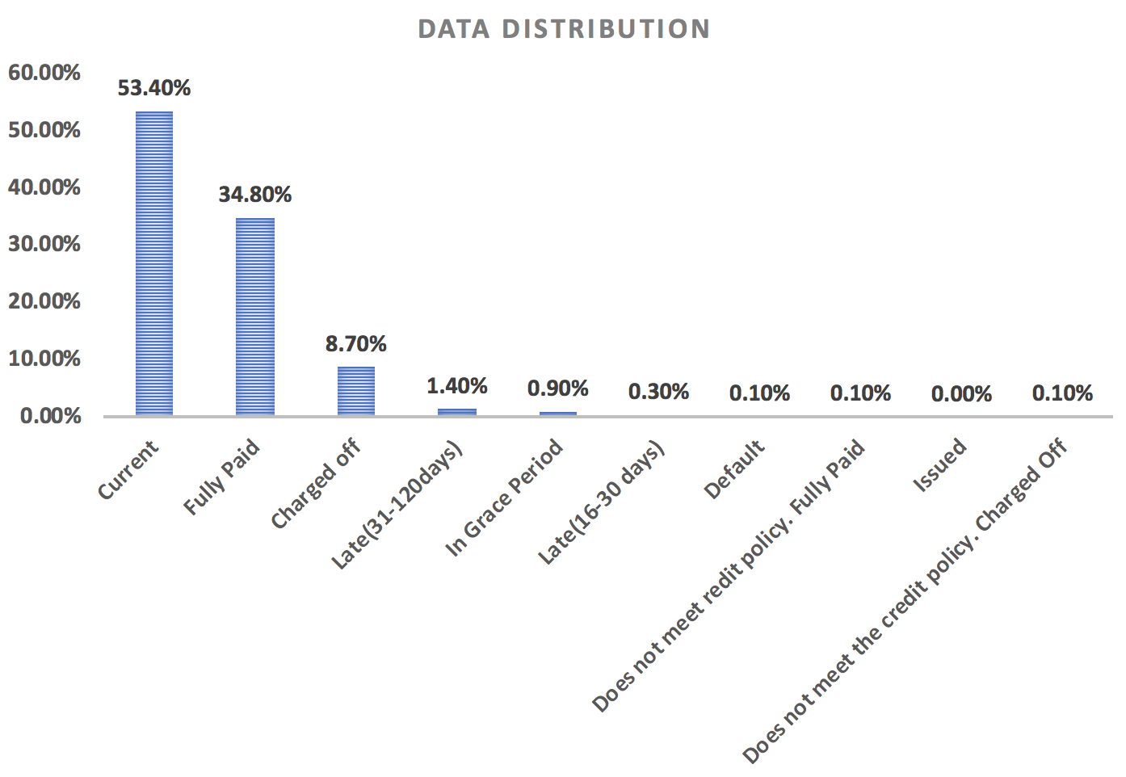
What is our data distribution?

Slide 5


What is our data distribution?
Good Status

Slide 6
Data Preprocessing
Features
136
1st Process nan-value
Delete column with large proportion empty
Data imputation by column average value
2nd Create dummy variables
3rd Check variables correlation
Delete high correlated variables
4th Data Balance
Original contains 13000K “good” and 2000K “bad” records
Random pick 25K “good” and 25K “bad” as training data
5th Apply dimensional reduction tool (PCA)
75
68
45

Slide 7
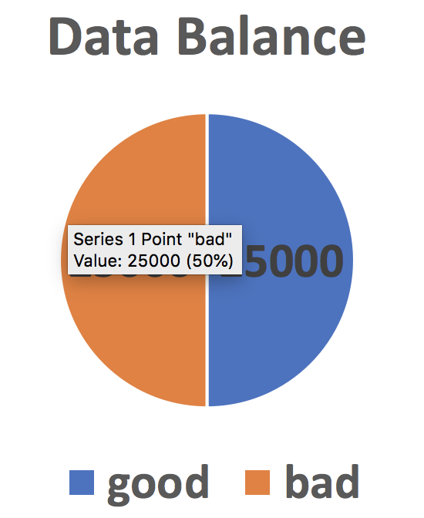
Data Preprocessing

Slide 8
Method 1: SVM

Slide 9
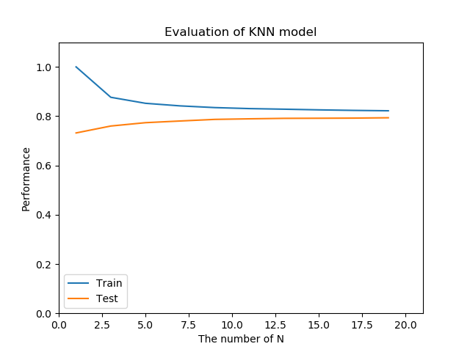
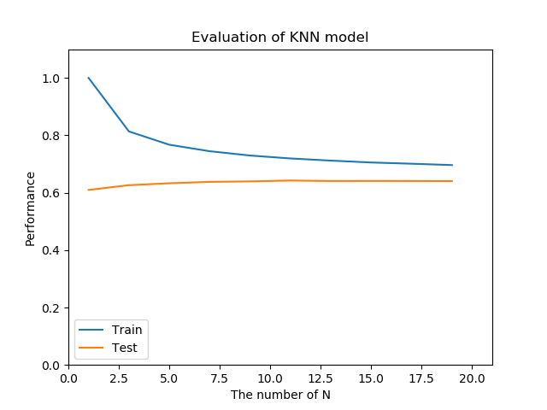
Method 2: k-NN Parameters choose
Notes:
Ensemble learning is the process by which multiple models, such as classifiers or experts, are strategically generated and combined to solve a particular computational intelligence problem. For example, it can be used for text mining, recommendation system, etc. Ensemble learning is primarily used to improve the (classification, prediction, function approximation, etc.) performance of a model, or reduce the likelihood of an unfortunate selection of a poor one.

Slide 10
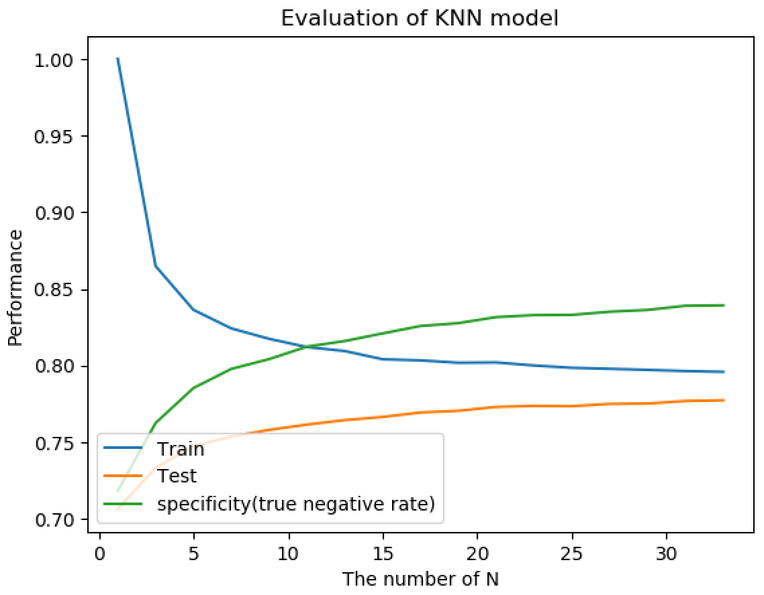
Method 2: k-NN Performance
Notes:
Ensemble learning is the process by which multiple models, such as classifiers or experts, are strategically generated and combined to solve a particular computational intelligence problem. For example, it can be used for text mining, recommendation system, etc. Ensemble learning is primarily used to improve the (classification, prediction, function approximation, etc.) performance of a model, or reduce the likelihood of an unfortunate selection of a poor one.

Slide 11
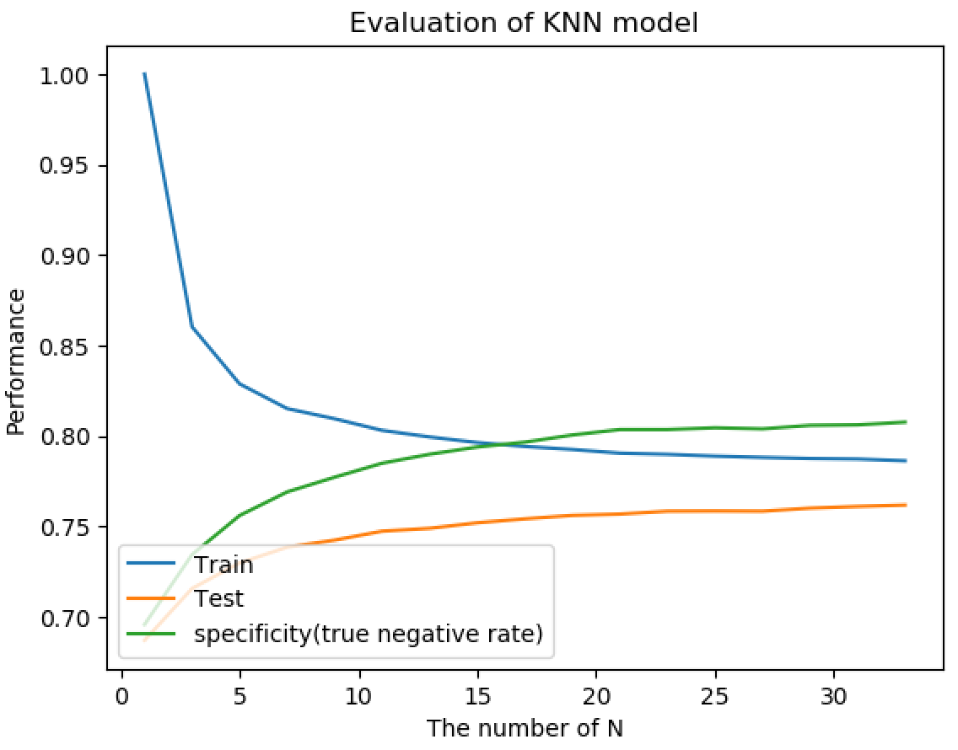
Method 2: k-NN with PCA
Notes:
Ensemble learning is the process by which multiple models, such as classifiers or experts, are strategically generated and combined to solve a particular computational intelligence problem. For example, it can be used for text mining, recommendation system, etc. Ensemble learning is primarily used to improve the (classification, prediction, function approximation, etc.) performance of a model, or reduce the likelihood of an unfortunate selection of a poor one.

Slide 12
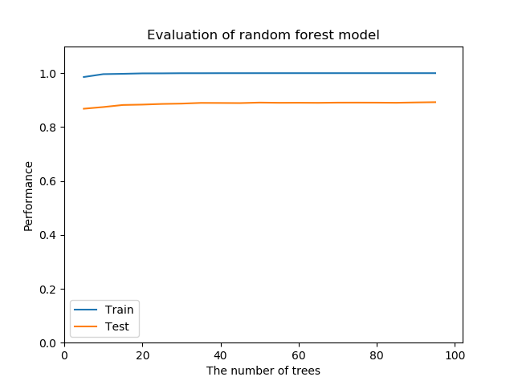
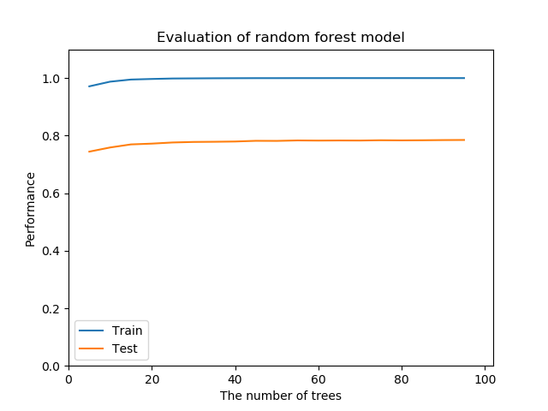
Method 3: Random Forests Parameters Choose
Notes:
Ensemble learning is the process by which multiple models, such as classifiers or experts, are strategically generated and combined to solve a particular computational intelligence problem. For example, it can be used for text mining, recommendation system, etc. Ensemble learning is primarily used to improve the (classification, prediction, function approximation, etc.) performance of a model, or reduce the likelihood of an unfortunate selection of a poor one.

Slide 13
Method 3: Random Forests Performance
Notes:
Ensemble learning is the process by which multiple models, such as classifiers or experts, are strategically generated and combined to solve a particular computational intelligence problem. For example, it can be used for text mining, recommendation system, etc. Ensemble learning is primarily used to improve the (classification, prediction, function approximation, etc.) performance of a model, or reduce the likelihood of an unfortunate selection of a poor one.

Slide 14
Method 3: Random Forests with PCA
Notes:
Ensemble learning is the process by which multiple models, such as classifiers or experts, are strategically generated and combined to solve a particular computational intelligence problem. For example, it can be used for text mining, recommendation system, etc. Ensemble learning is primarily used to improve the (classification, prediction, function approximation, etc.) performance of a model, or reduce the likelihood of an unfortunate selection of a poor one.

Slide 15
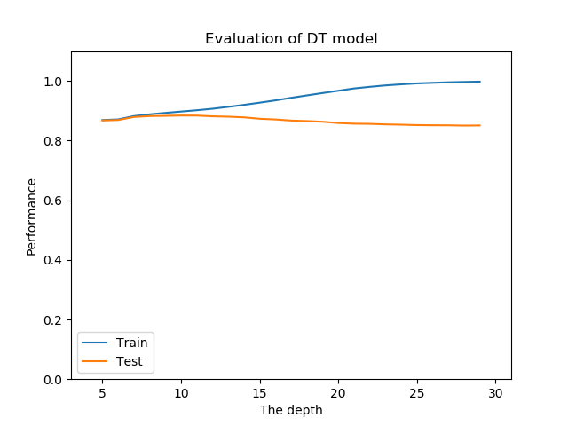
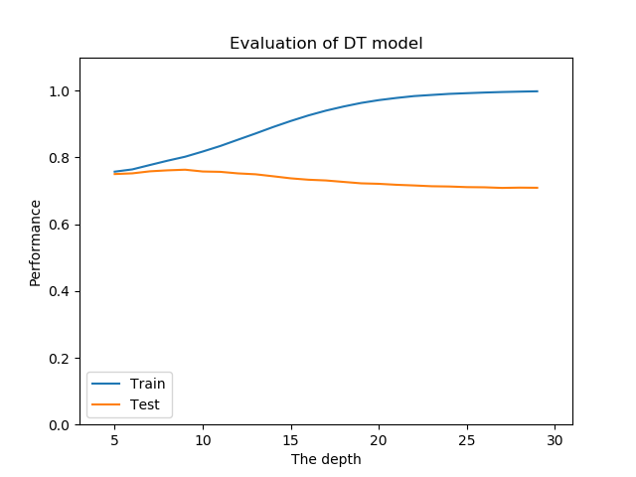
Method 4: Decision Tree Parameters choose
Notes:
Ensemble learning is the process by which multiple models, such as classifiers or experts, are strategically generated and combined to solve a particular computational intelligence problem. For example, it can be used for text mining, recommendation system, etc. Ensemble learning is primarily used to improve the (classification, prediction, function approximation, etc.) performance of a model, or reduce the likelihood of an unfortunate selection of a poor one.

Slide 16
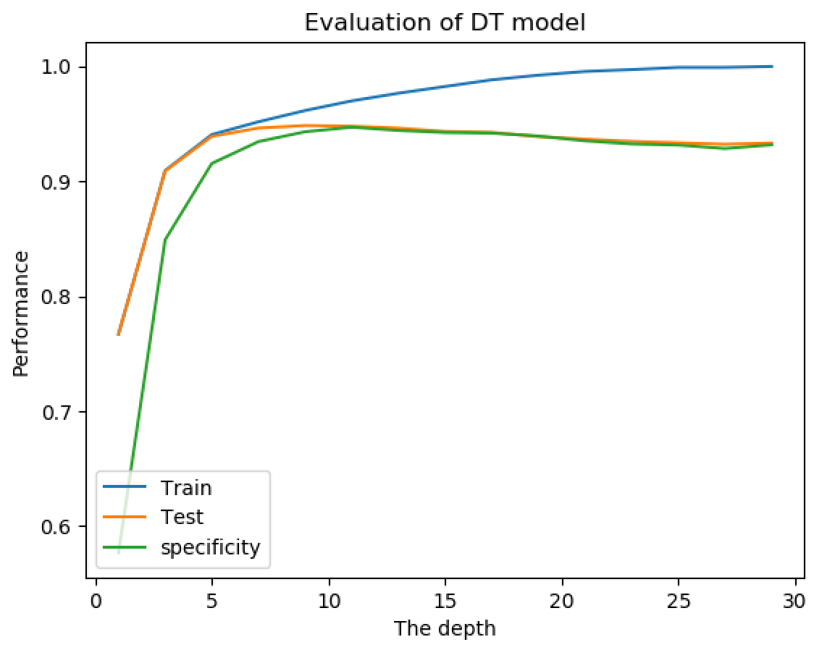
Method 4: Decision Tree Performance
Notes:
Ensemble learning is the process by which multiple models, such as classifiers or experts, are strategically generated and combined to solve a particular computational intelligence problem. For example, it can be used for text mining, recommendation system, etc. Ensemble learning is primarily used to improve the (classification, prediction, function approximation, etc.) performance of a model, or reduce the likelihood of an unfortunate selection of a poor one.

Slide 17
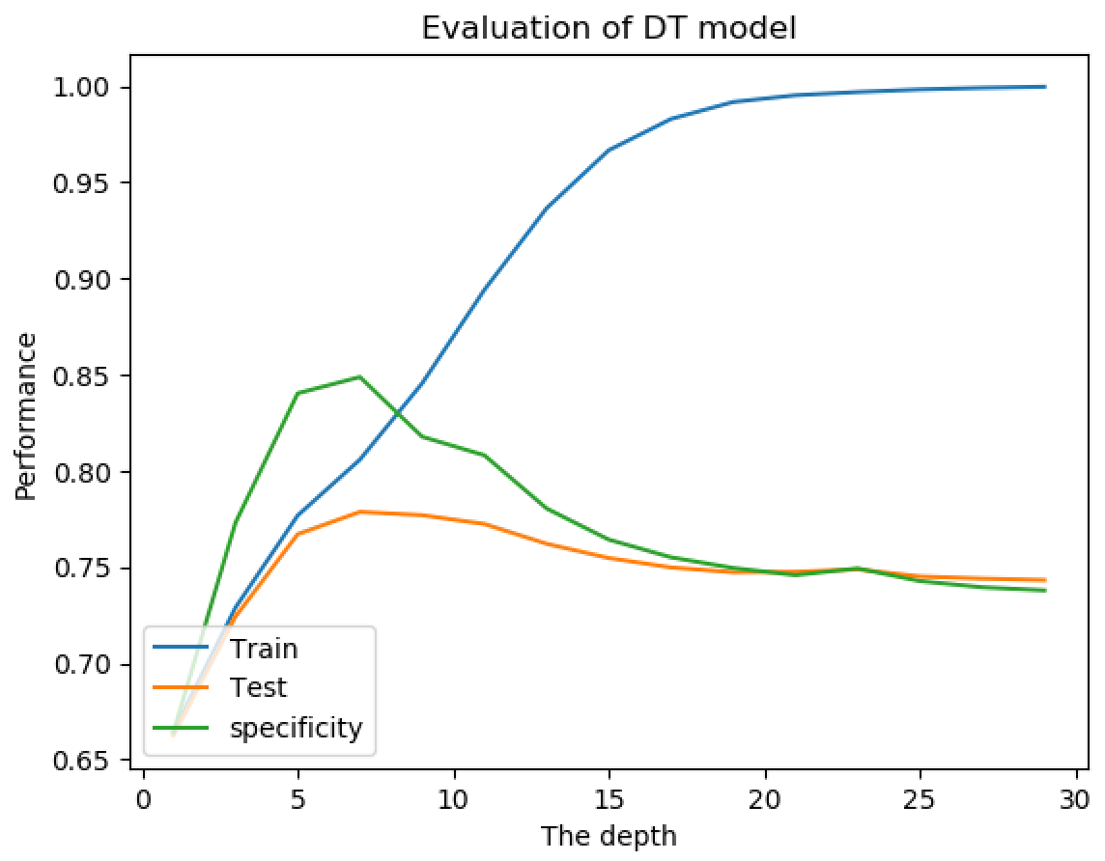
Method 4: Decision Tree after PCA
Notes:
Ensemble learning is the process by which multiple models, such as classifiers or experts, are strategically generated and combined to solve a particular computational intelligence problem. For example, it can be used for text mining, recommendation system, etc. Ensemble learning is primarily used to improve the (classification, prediction, function approximation, etc.) performance of a model, or reduce the likelihood of an unfortunate selection of a poor one.

Slide 18
Method 4: Decision Tree with Adaboost
Notes:
Ensemble learning is the process by which multiple models, such as classifiers or experts, are strategically generated and combined to solve a particular computational intelligence problem. For example, it can be used for text mining, recommendation system, etc. Ensemble learning is primarily used to improve the (classification, prediction, function approximation, etc.) performance of a model, or reduce the likelihood of an unfortunate selection of a poor one.

Slide 19
Method 4: Decision Tree with Adaboost after PCA
Notes:
Ensemble learning is the process by which multiple models, such as classifiers or experts, are strategically generated and combined to solve a particular computational intelligence problem. For example, it can be used for text mining, recommendation system, etc. Ensemble learning is primarily used to improve the (classification, prediction, function approximation, etc.) performance of a model, or reduce the likelihood of an unfortunate selection of a poor one.

Slide 20
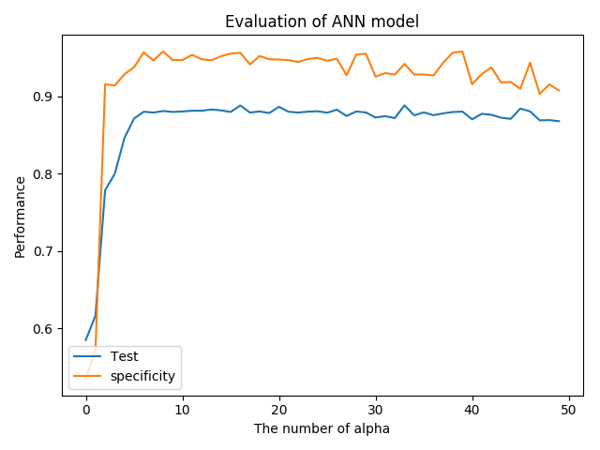
Method 5: Neural Network
Notes:
Ensemble learning is the process by which multiple models, such as classifiers or experts, are strategically generated and combined to solve a particular computational intelligence problem. For example, it can be used for text mining, recommendation system, etc. Ensemble learning is primarily used to improve the (classification, prediction, function approximation, etc.) performance of a model, or reduce the likelihood of an unfortunate selection of a poor one.

Slide 21
Training Accuracy Comparison
 | KNN | SVM | DT | RF
Down sample |  | linear﻿ 0.8899
 |  | poly﻿ 0.8953
 |  | rbf﻿ 0.8944
 |  | sigmoid ﻿ 0.7604
Down Sample with PCA |  | linear
 |  | poly
 |  | rbf
 |  | sigmoid

Slide 22
Test Accuracy Comparison
 | KNN | SVM | DT | RF
Down sample | ﻿0.7620 | linear﻿ 0.8898 | Ada ﻿0.8508 | ﻿0.8936
 |  | poly﻿ 0.8674
 |  | rbf﻿ ﻿0.8796 | ﻿﻿0.9265
 |  | sigmoid ﻿ ﻿0.7607
Down Sample with PCA | ﻿﻿0.7462 | linear | Ada ﻿0.7033﻿ | ﻿0.7889
 |  | poly
 |  | rbf | ﻿﻿0.7483
 |  | sigmoid

Slide 23
Test Specificity Comparison
 | KNN | SVM | DT | RF
Down sample | ﻿﻿0.8128 | linear﻿ | Ada ﻿﻿0.8478 | ﻿0.9748
 |  | poly﻿
 |  | rbf﻿ ﻿ | ﻿﻿ 0.9061
 |  | sigmoid ﻿ ﻿
Down Sample with PCA | ﻿0.7842 | linear | Ada﻿﻿ 0.7068 | ﻿0.7835
 |  | poly
 |  | rbf | ﻿0.7677
 |  | sigmoid

Slide 24
Reference
[1] Peter Flach, Cambridge University Press. The Art and Science of Algorithms That Make Sense of Data
[2] Kyumin Lee, Worcester Polytechnic Institute Lecture Slides: CS539 Machine Learning
[3] In Depth: Principal Component Analysis https://jakevdp.github.io/PythonDataScienceHandbook/05.09-principal-component-analysis.html
Notes:
Ensemble learning is the process by which multiple models, such as classifiers or experts, are strategically generated and combined to solve a particular computational intelligence problem. For example, it can be used for text mining, recommendation system, etc. Ensemble learning is primarily used to improve the (classification, prediction, function approximation, etc.) performance of a model, or reduce the likelihood of an unfortunate selection of a poor one.

Slide 25
Thank you!
Questions?

